Slide 1


DATA ANALYTICS TEAM INFERNO DA-14

Slide 2

CASE STUDY USING SPSS SOFTWARE
SPSS Statistics is a statistical software suite developed by IBM for data management, advanced analytics, multivariate analysis, business intelligence, criminal investigation. Long produced by SPSS Inc., it was acquired by IBM in 2009.
SPSS (Statistical Package for the Social Sciences), also known as IBM SPSS Statistics, is a software package used for the analysis of statistical data. Although the name of SPSS reflects its original use in the field of social sciences, its use has since expanded into other data markets.

Slide 3
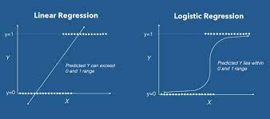
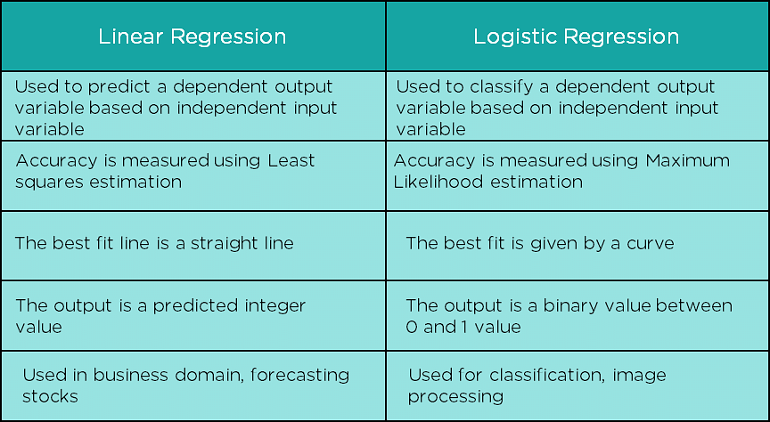
What is linear regression in data analytics?
Linear regression analysis is used to predict the value of a variable based on the value of another variable. The variable you want to predict is called the dependent variable. The variable you are using to predict the other variable's value is called the independent variable.
In statistical modeling, regression analysis is a set of statistical processes for estimating the relationships between a dependent variable and one or more independent variables.
What is Logistic Regression in Data Analytics –
Logistic regression is a process of modeling the probability of a discrete outcome given an input variable. The most common logistic regression models a binary outcome; something that can take two values such as true/false, yes/no, and so on.

Slide 4
Binary Logistic Regression –
Binary logistic regression (LR) is a regression model where the target variable is binary, that is, it can take only two values, 0 or 1. It is the most utilized regression model in readmission prediction, given that the output is modelled as readmitted (1) or not readmitted (0).
Multinomial Logistic Regression –
Multinomial logistic regression is a simple extension of binary logistic regression that allows for more than two categories of the dependent or outcome variable. Like binary logistic regression, multinomial logistic regression uses maximum likelihood estimation to evaluate the probability of categorical membership.

Slide 5
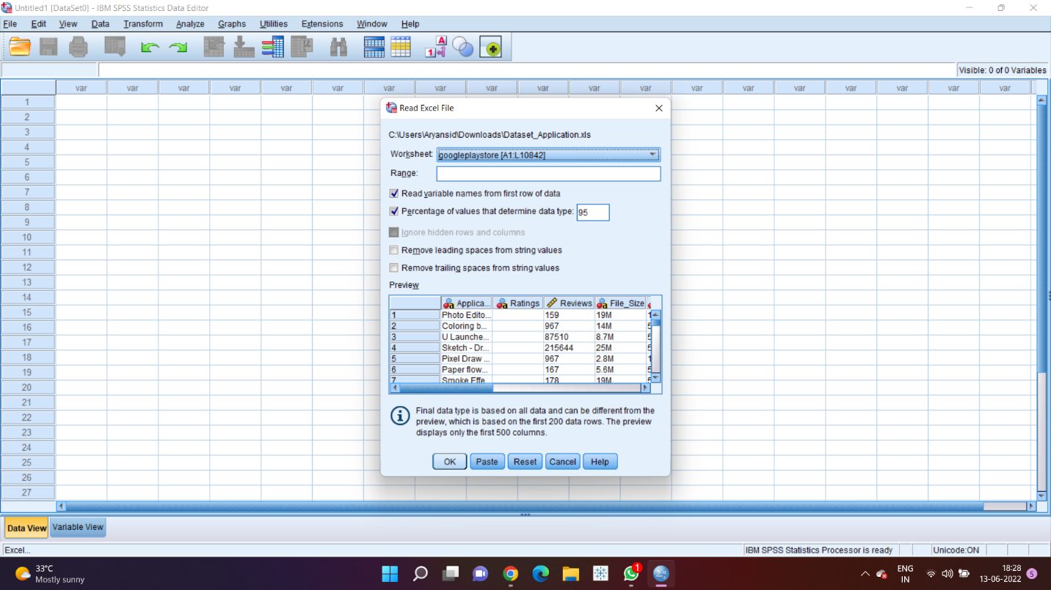
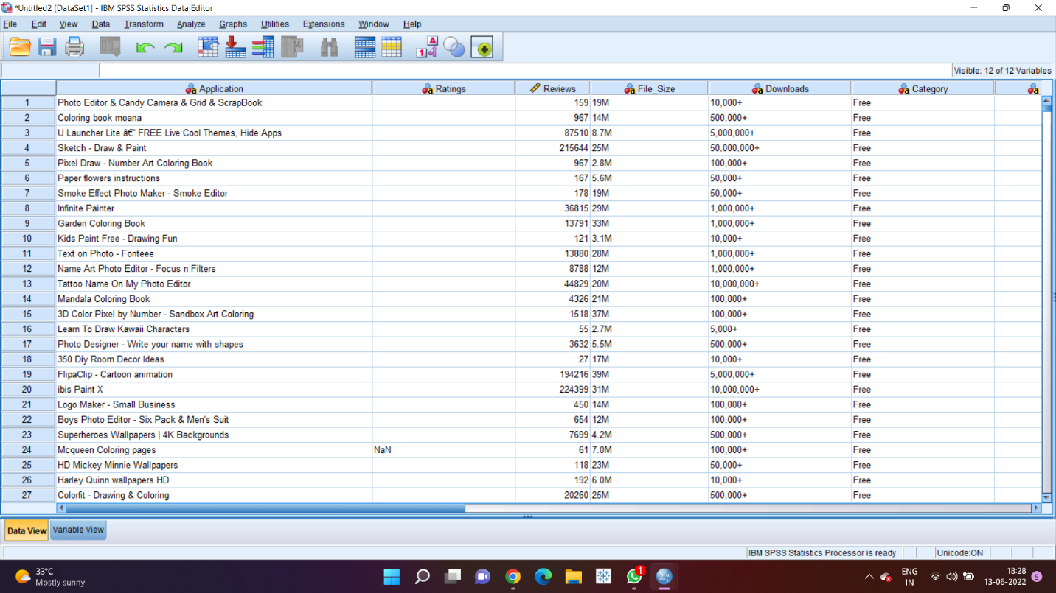
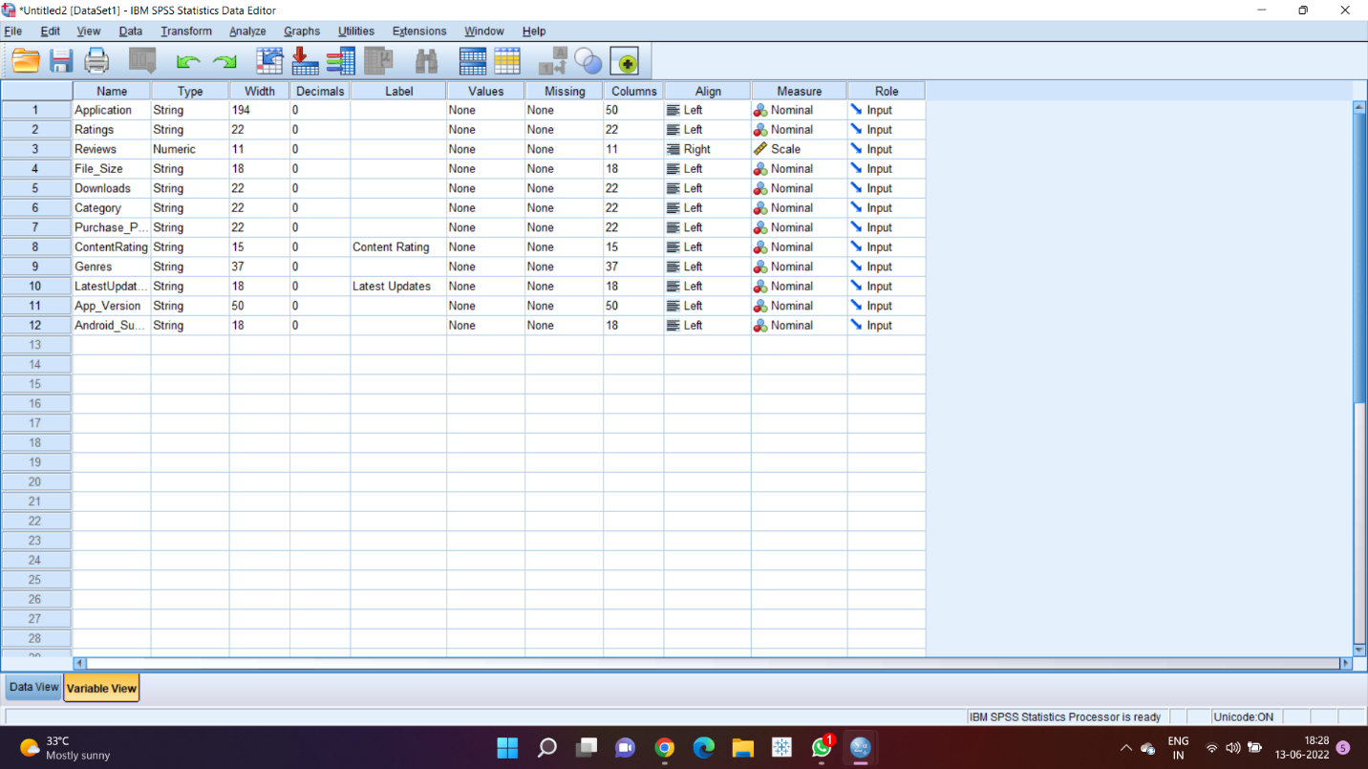
Import the dataset into the IBM SPSS Statistics 26.
We observe the data view and the variable view

Slide 6
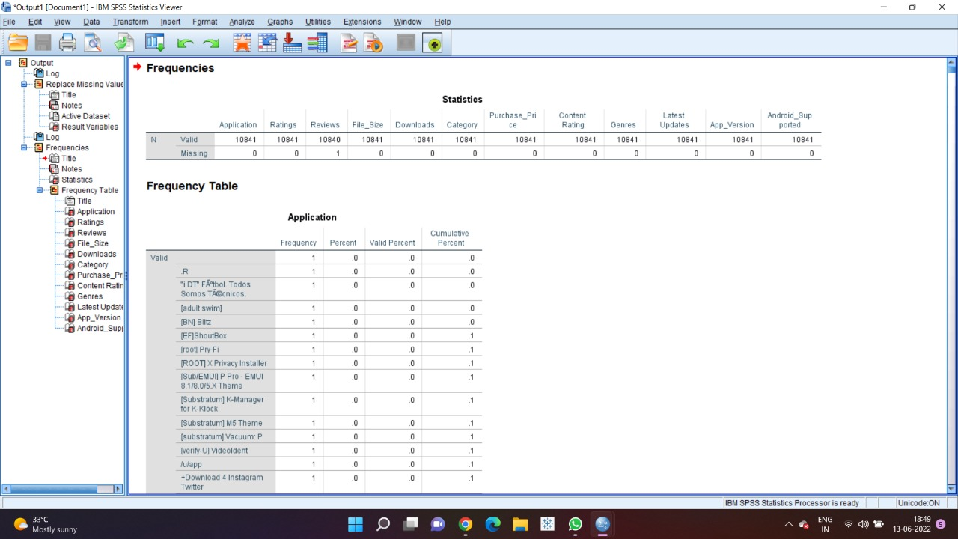
Descriptive Statistics in order to observe the complete analysis of the given dataset. It also helps in finding if the variables have a set of missing values or not.
Descriptive statistics are brief descriptive coefficients that summarize a given data set, which can be either a representation of the entire population or a sample of a population. Descriptive statistics are broken down into measures of central tendency and measures of variability (spread). Measures of central tendency include the mean, median, and mode, while measures of variability include standard deviation, variance, minimum and maximum variables.

Slide 7
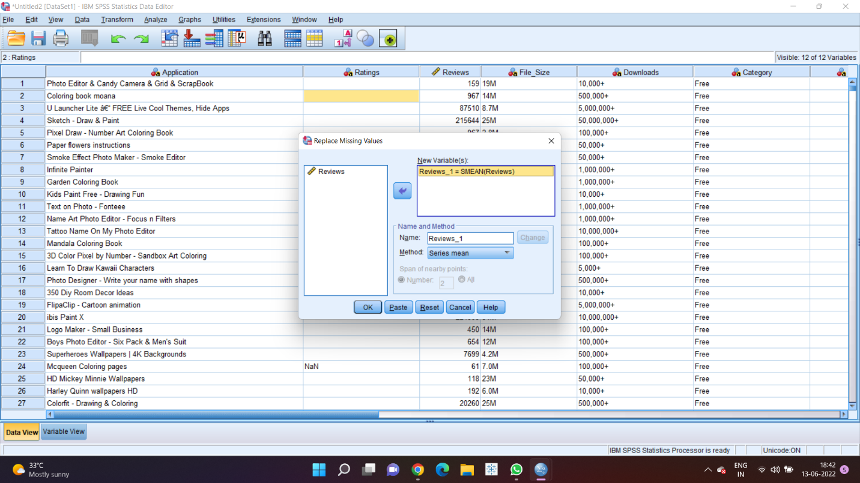
Since we identify that the reviews column consists of missing values, we perform data cleaning by replacing the missing values by the mean of all the values consisting in the reviews column.

Slide 8
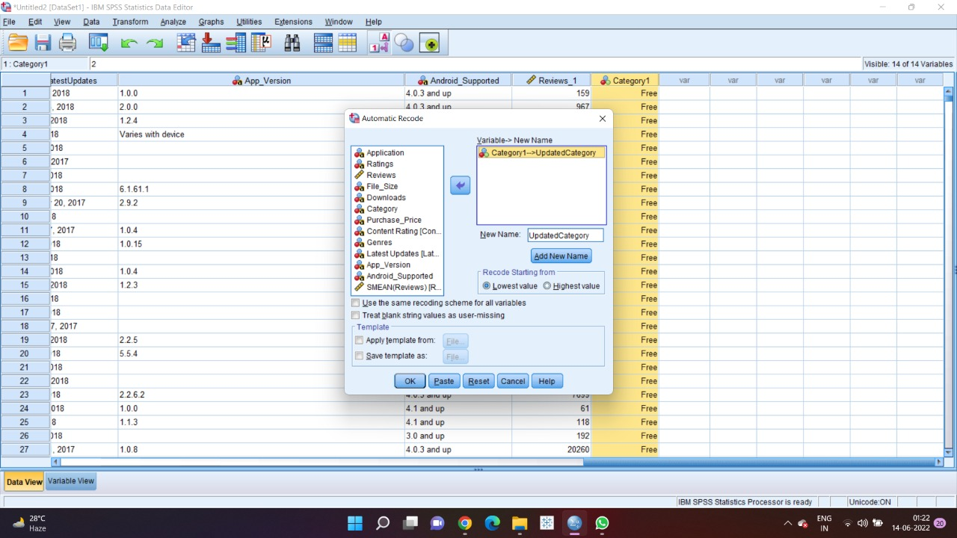
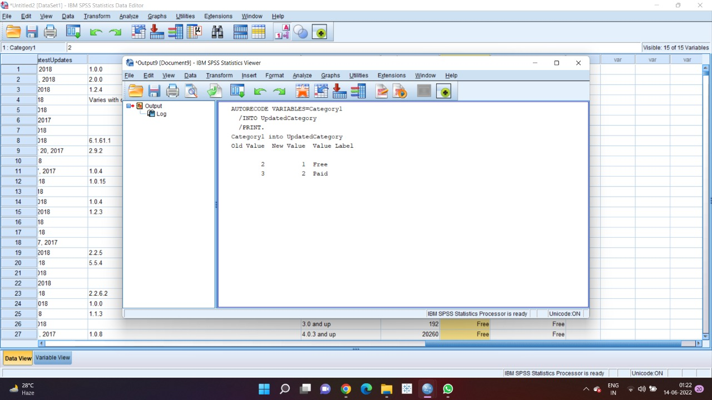
Now its time to convert relevant data attributes into nominal values in order to perform regression to identify the correlation between different data fields and their influence in attaining majority of the downloads.
CATEGORY is transformed into a nominal data field by Automatic Recode function

Slide 9
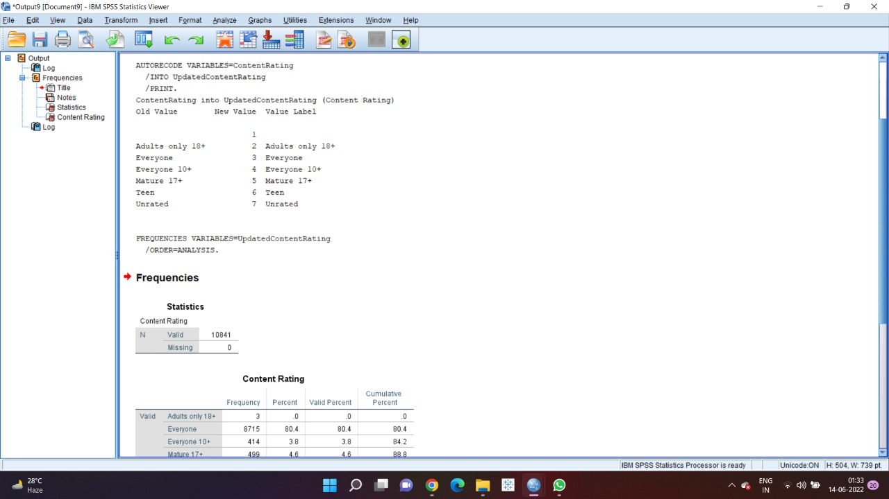
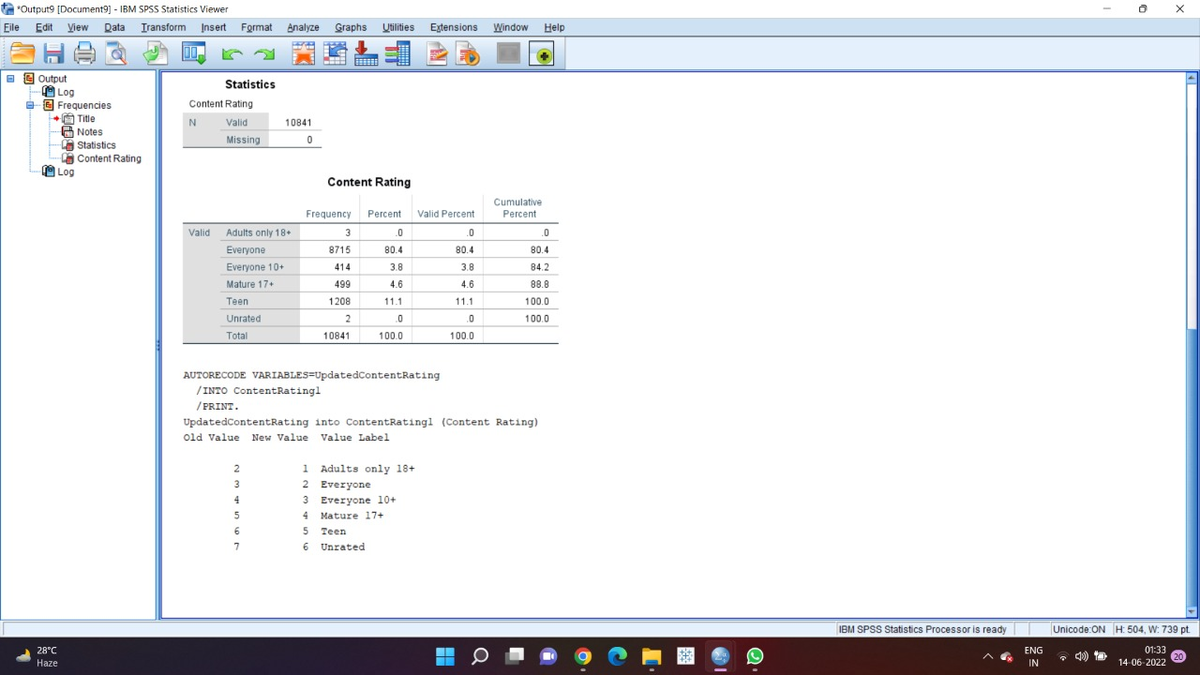
Content Rating is transformed into a nominal data field by Automatic Recode function

Slide 10
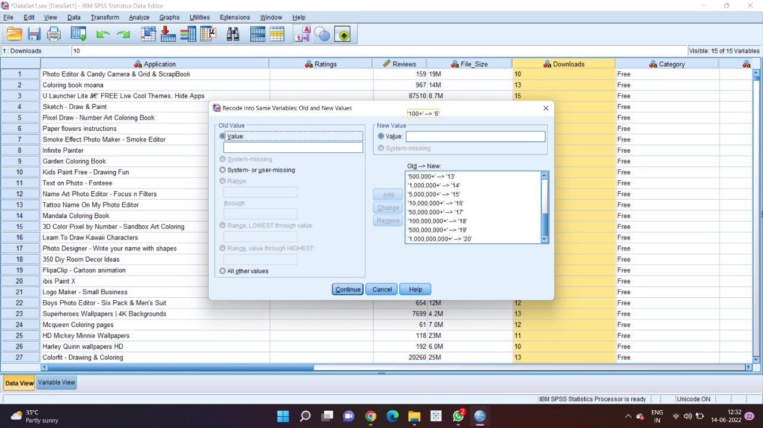
Downloads data field is considered to be our dependent nominal variable where we perform our multinomial logistic regression considering other nominal and scalar attributes and finding the correlation between them to give insights and reasons on what factors are influencing better downloads for the customers to perform. But the Downloads data field is a string data type, in order to make it a nominal datafield, we perform Recode into Same Variables: Old and New Values, which gives each range a ranking in an ascending order.

Slide 11
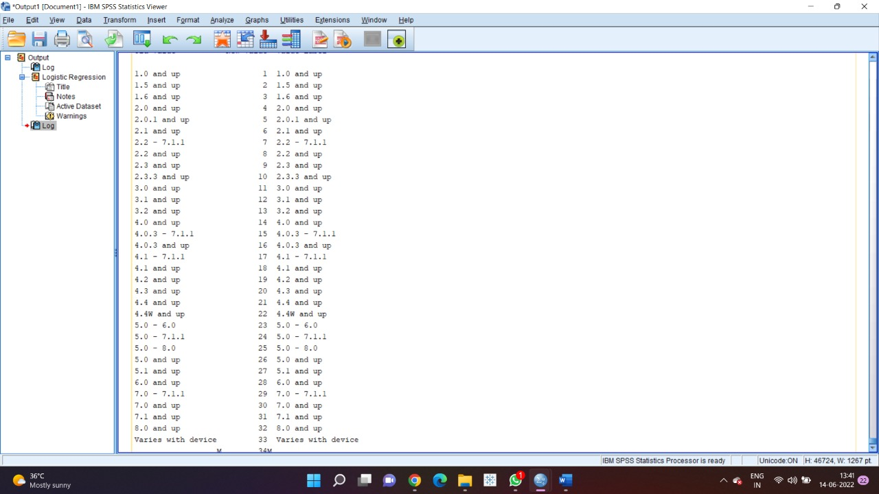
Android_Supported is transformed into a nominal data field by Automatic Recode function

Slide 12
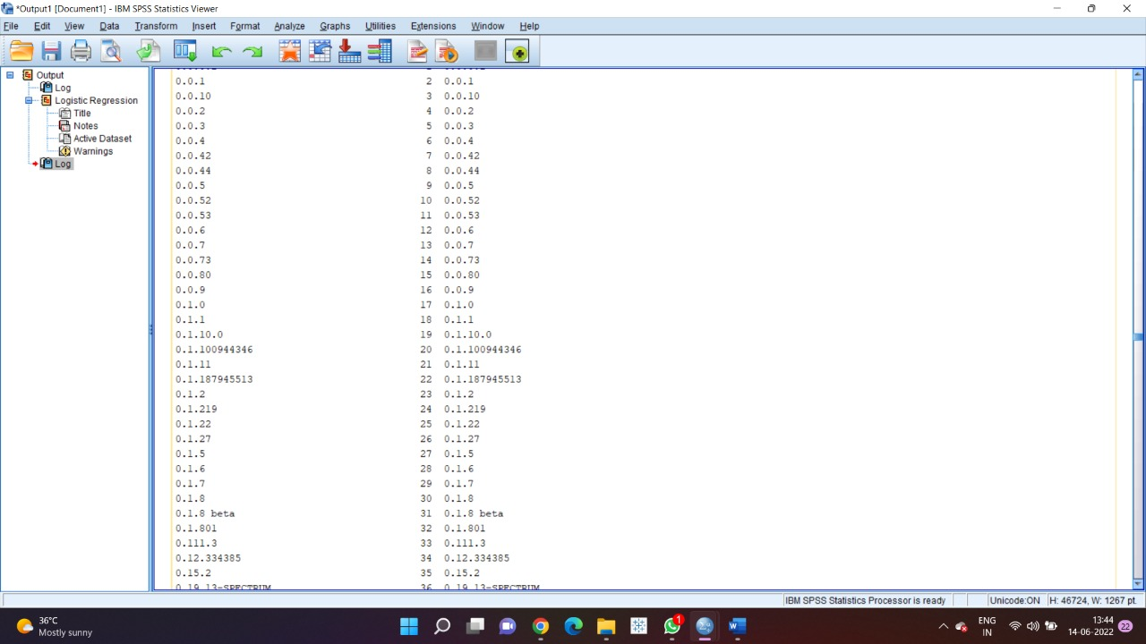
App_Version is transformed into a nominal data field by Automatic Recode function

Slide 13
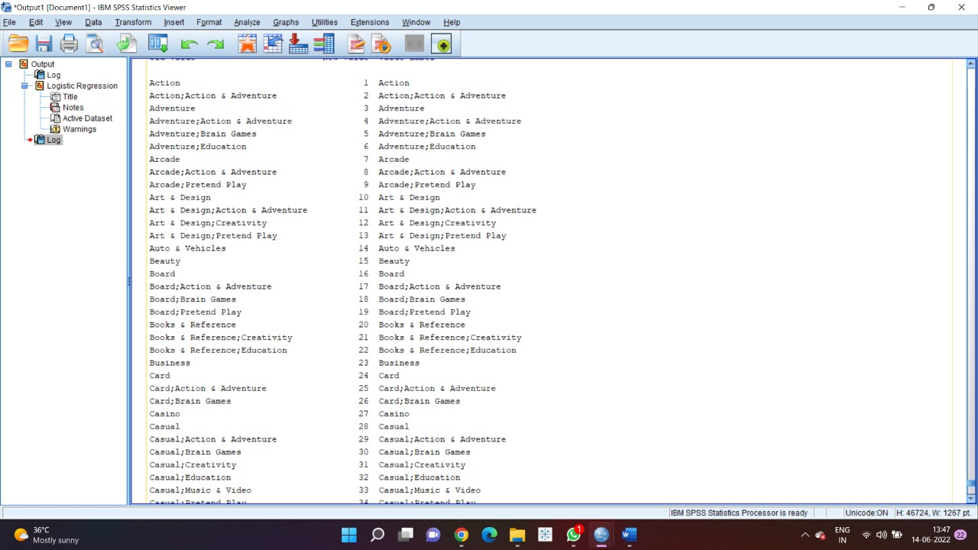
Content Rating is transformed into a nominal data field by Automatic Recode function

Slide 14
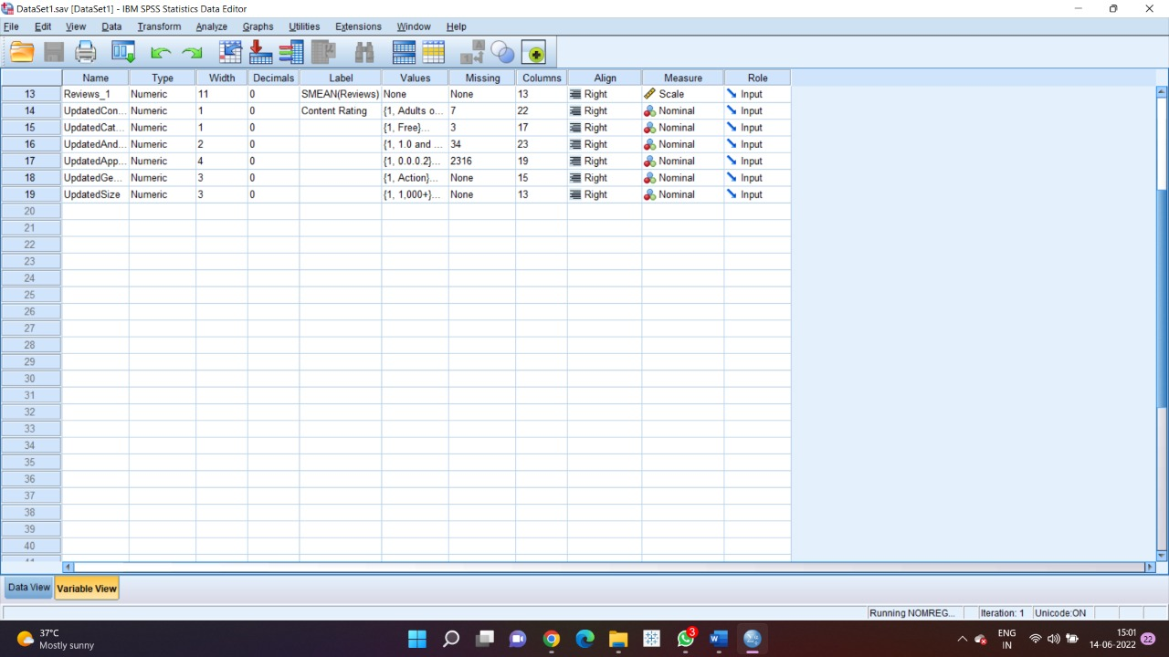
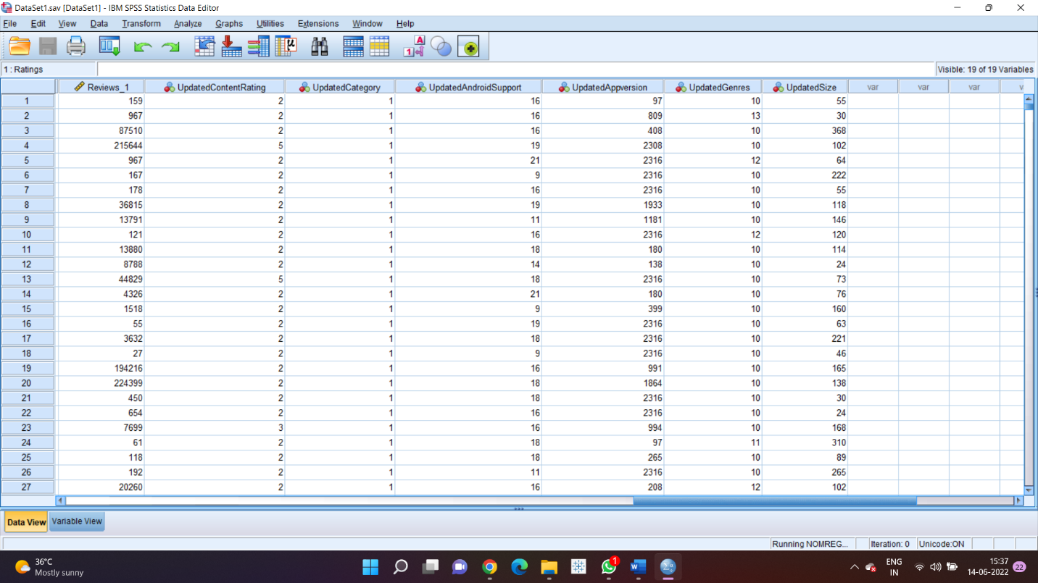
Updated Nominal Data Fields for Multinomial Logistic Regression

Slide 15
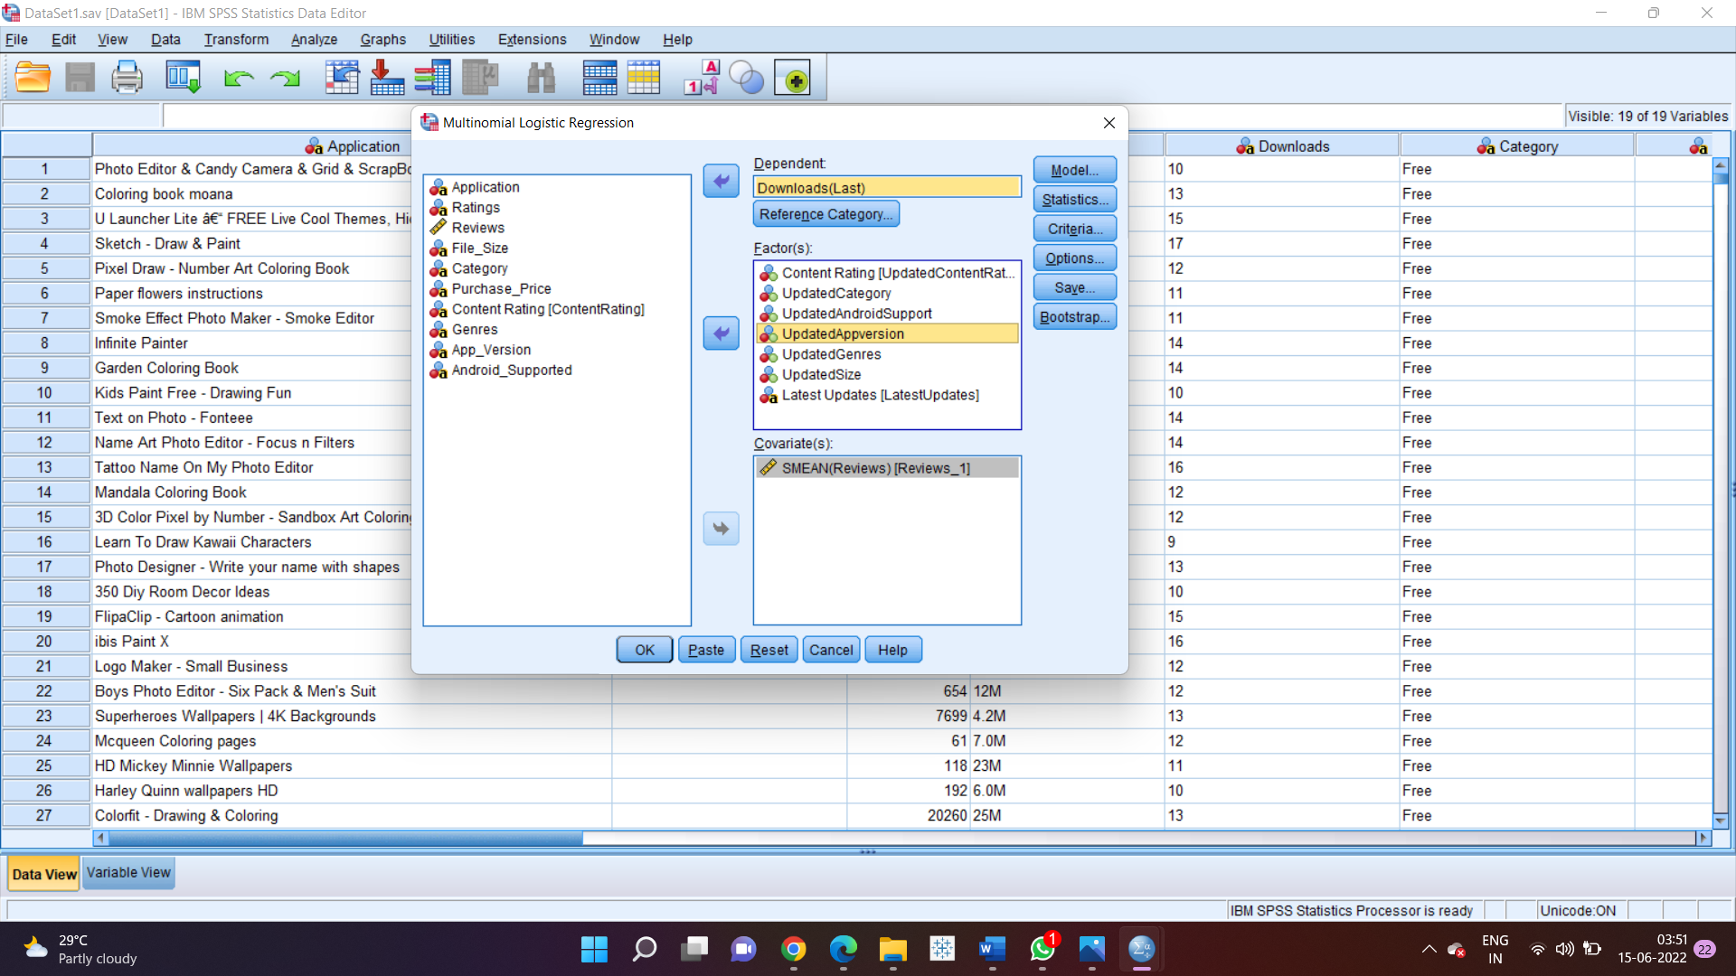
Since we have all the clean and required data to perform multinomial logistic regression, we take our dependent variable as Downloads, and consider all the nominal categorized data fields as factors, and the scalar variables are to be considered under Covariates, we run the following multinomial regression to infer insights and identify correlation.

Slide 16
Likelihood Ratio Tests
Effect | Model Fitting Criteria | Likelihood Ratio Tests
 | -2 Log Likelihood of Reduced Model | Chi-Square | df | Sig.
Intercept | 58104.079ª | .000 | 0 | .
Reviews_1 | 47959.335^{b} | . | 19 | .
Updated Content Rating | 58885.418^{c} | 781.339 | 95 | .000
Likelihood Ratio Tests
Effect | Model Fitting Criteria | Likelihood Ratio Tests
 | -2 Log Likelihood of Reduced Model | Chi-Square | df | Sig.
Intercept | 3623.170ª | .000 | 0 | .
Updated Android Support | 3728.846 | 105.676 | 627 | 1.000
Likelihood Ratio Tests
Effect | Model Fitting Criteria | Likelihood Ratio Tests
 | -2 Log Likelihood of Reduced Model | Chi-Square | df | Sig.
Intercept | 210.289ª | .000 | 0 | .
Updated Category | 1082.374 | 872.086 | 19 | .000
Likelihood Ratio Tests
Effect | Model Fitting Criteria | Likelihood Ratio Tests
 | -2 Log Likelihood of Reduced Model | Chi-Square | df | Sig.
Intercept | 4945.780ª | .000 | 0 | .
Updated Genres | 7273.633 | 2327.853 | 2242 | .101
The chi-square statistic is the difference in -2 log likelihoods between the final model and a reduced model. The reduced model is formed by omitting an effect from the final model. The null hypothesis is that all parameters of that effect are 0.
a. This reduced model is equivalent to the final model because omitting the effect does not increase the degrees of freedom.
b. Un-expected singularities in the Hessian matrix are encountered. This indicates that either some predictor variables should be excluded or some categories should be merged.
c. The log-likelihood value cannot be further increased after maximum number of step-halving.

Slide 17
These are the livelihood tests of respective data fields.
(Note: Few data fields show an error of less memory and do not show the results)
Data Fields with a significance level of less than 0.05 are supposed to be considered for correlation, showing that the following data field variable is influencing the dependent variable.
From the above likelihood ratio tests, we come to a conclusion that content rating and category influence the number of downloads by the customer as they show a significance value less than 0.05. Android_Support and Genres do not make an impact on the number of downloads due to their significance level being greater than 0.05

Slide 18
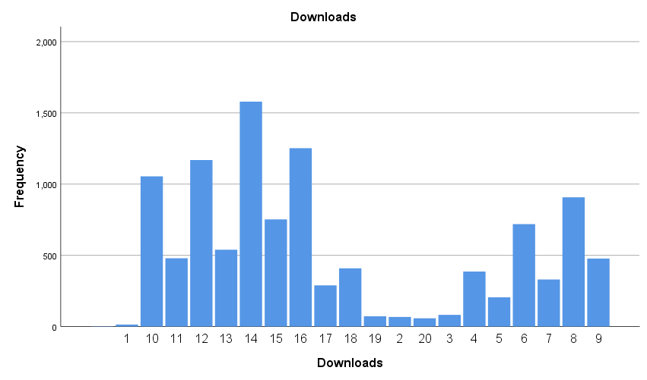
Top 100 apps in taking consideration of all the apps and Bottom 100 apps taking various parameters –
Bar Chart
Downloads and its frequency, identifying the nominal categories for their value labels.

Slide 19
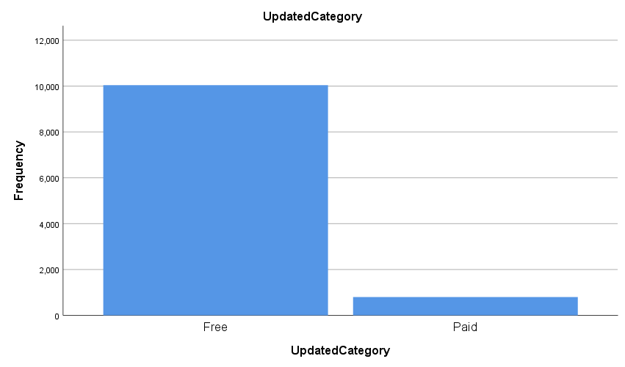
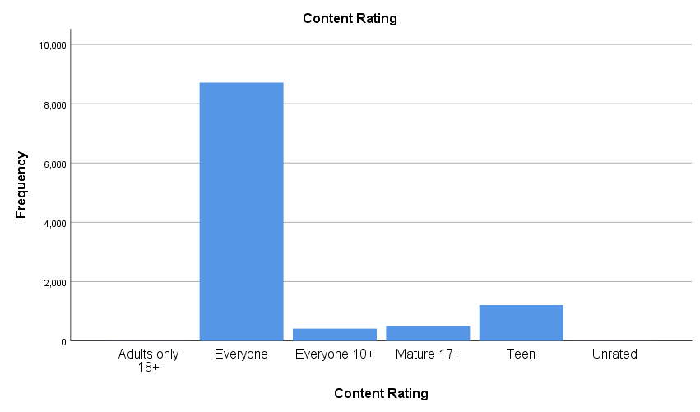

Slide 20
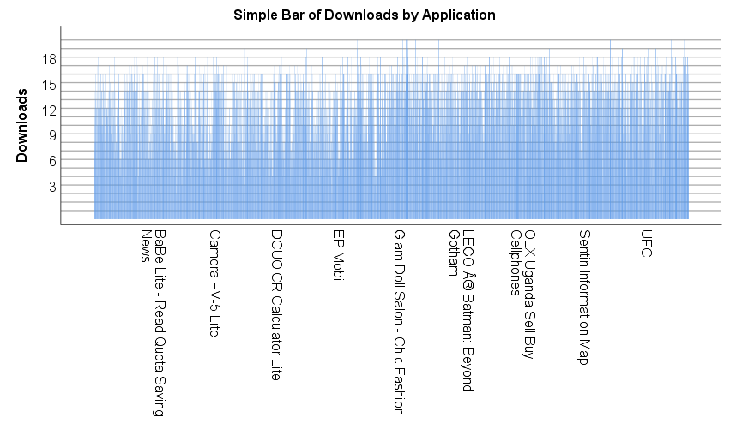

Slide 21
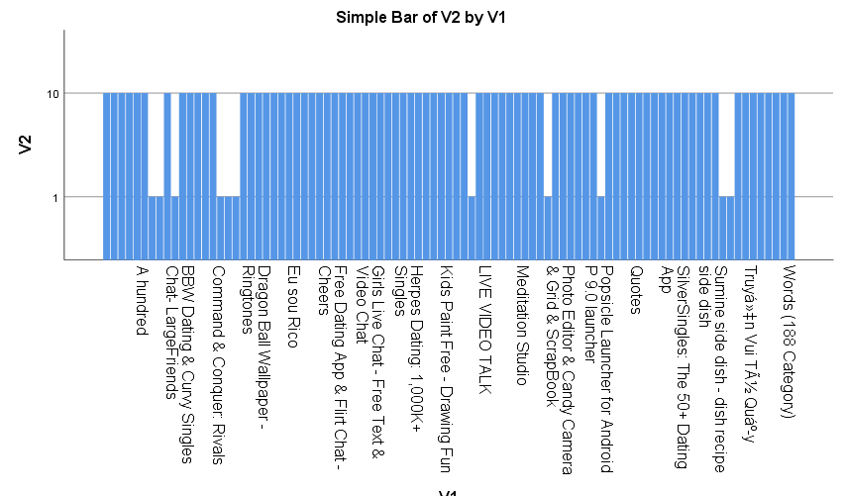
BOTTOM 100 APP DOWNLOADS –
For enlisting the top 100 applications and bottom 100 applications and identifying factors that influenced their results, we sorted the nominal downloads data and collected the top 100 and bottom 100 applications and then performed descriptive analytics to attain visualizations and regression to identify the data fields which influence the details.
From the above and obtained results, we tend to find the influence of same datafields which influenced the overall number of downloads.

Slide 22

Regression Analysis in Excel
Microsoft Excel enables users to format, organize and calculate data in a spreadsheet. By organizing data using software like Excel, data analysts and other users can make information easier to view as data is added or changed. Excel contains a large number of boxes called cells that are ordered in rows and columns.
A successful Excel spreadsheet will organize raw data into a readable format that makes it easier to extract actionable insights. With more complex data, Excel allows you to customize fields and functions that make calculations for you.

Slide 23
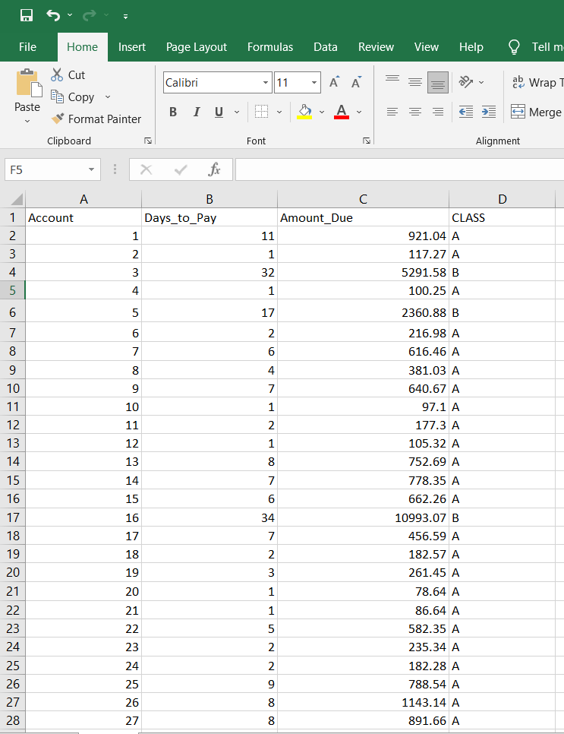
Linear Regression Analysis –
Linear regression analysis is used to predict the value of a variable based on the value of another variable. The variable you want to predict is called the dependent variable. The variable you are using to predict the other variable's value is called the independent variable.
In statistics, linear regression is a linear approach for modelling the relationship between a scalar response and one or more explanatory variables. The case of one explanatory variable is called simple linear regression; for more than one, the process is called multiple linear regression.

Slide 24
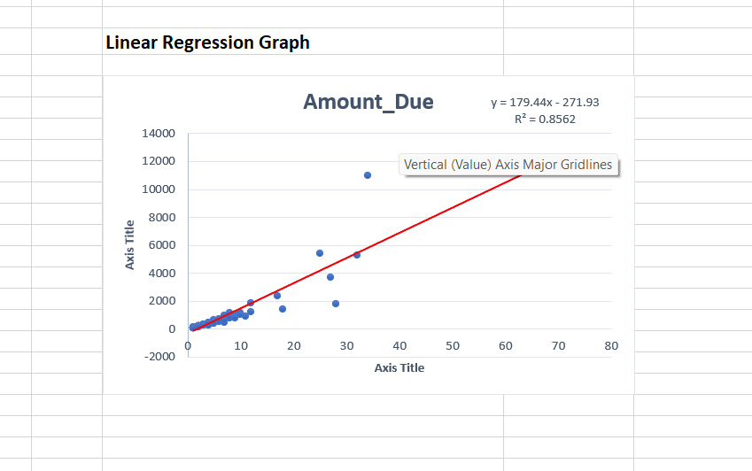
Linear regression is a statistical technique/method used to study the relationship between two continuous quantitative variables. In this technique, independent variables are used to predict the value of a dependent variable.
The first step in running regression analysis in Excel is to double-check that the free Excel plugin Data Analysis ToolPak is installed. This plugin makes calculating a range of statistics very easy. It is not required to chart a linear regression line, but it makes creating statistics tables simpler. To verify if installed, select "Data" from the toolbar.

Slide 25
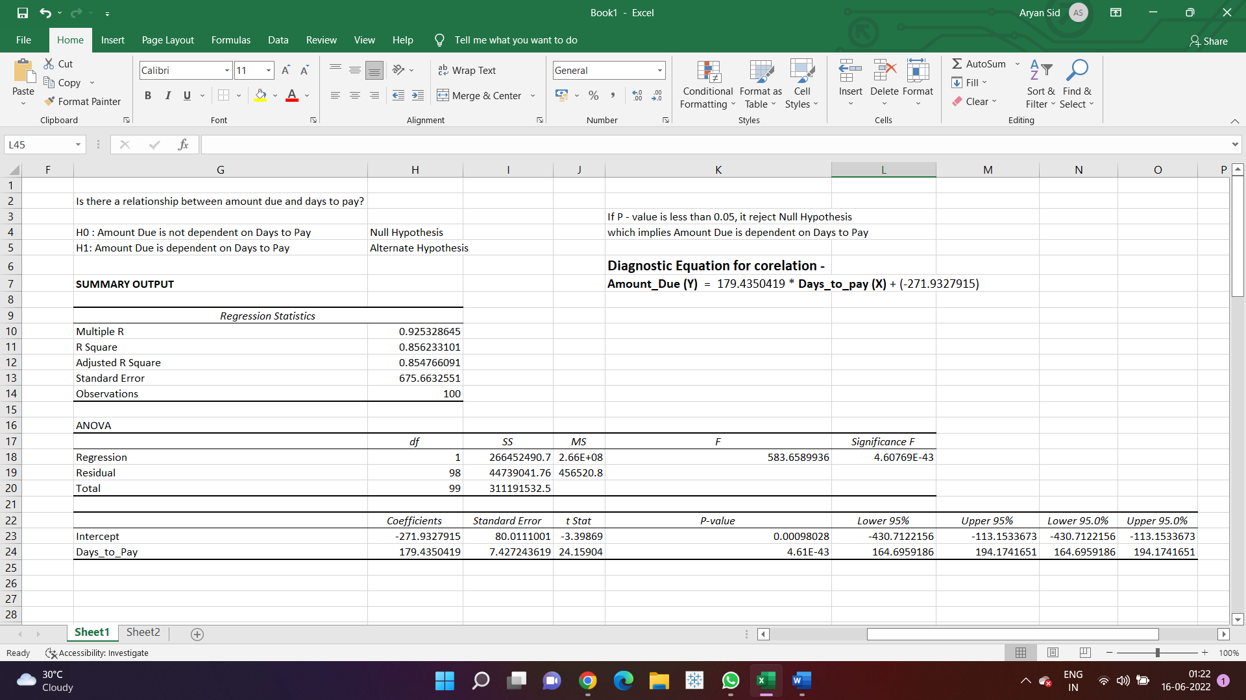

Slide 26
Multiple R. It is the Correlation Coefficient that measures the strength of a linear relationship between two variables. The correlation coefficient can be any value between -1 and 1, and its absolute value indicates the relationship strength. The larger the absolute value, the stronger the relationship:
1 means a strong positive relationship
-1 means a strong negative relationship
0 means no relationship at all
R Square. It is the Coefficient of Determination, which is used as an indicator of the goodness of fit. It shows how many points fall on the regression line. The R2 value is calculated from the total sum of squares, more precisely, it is the sum of the squared deviations of the original data from the mean.
Adjusted R Square. It is the R square adjusted for the number of independent variable in the model. You will want to use this value instead of R square for multiple regression analysis.
Standard Error. It is another goodness-of-fit measure that shows the precision of your regression analysis - the smaller the number, the more certain you can be about your regression equation. While R2 represents the percentage of the dependent variables variance that is explained by the model, Standard Error is an absolute measure that shows the average distance that the data points fall from the regression line.

Slide 27
Analysis of Variance (ANOVA):
Basically, it splits the sum of squares into individual components that give information about the levels of variability within your regression model:
df is the number of the degrees of freedom associated with the sources of variance.
SS is the sum of squares. The smaller the Residual SS compared with the Total SS, the better your model fits the data.
MS is the mean square.
F is the F statistic, or F-test for the null hypothesis. It is used to test the overall significance of the model.
Significance F is the P-value of F.
The ANOVA part is rarely used for a simple linear regression analysis in Excel, but you should definitely have a close look at the last component. The Significance F value gives an idea of how reliable (statistically significant) your results are. If Significance F is less than 0.05 (5%), your model is OK. If it is greater than 0.05, you'd probably better choose another independent variable.

Slide 28
T-Test Analysis in Excel
A t-test is a statistical test that is used to compare the means of two groups. It is often used in hypothesis testing to determine whether a process or treatment actually has an effect on the population of interest, or whether two groups are different from one another.
The t-test tells you how significant the differences between groups are. It can either be paired or unpaired t-test depending on whether the data is paired or unpaired. The ultimate goal for you is to find the p value and if it is less than 0.05 then there is significant difference between the two groups. If it is more than 0.05 then there is no significant difference between the two groups.

Slide 29
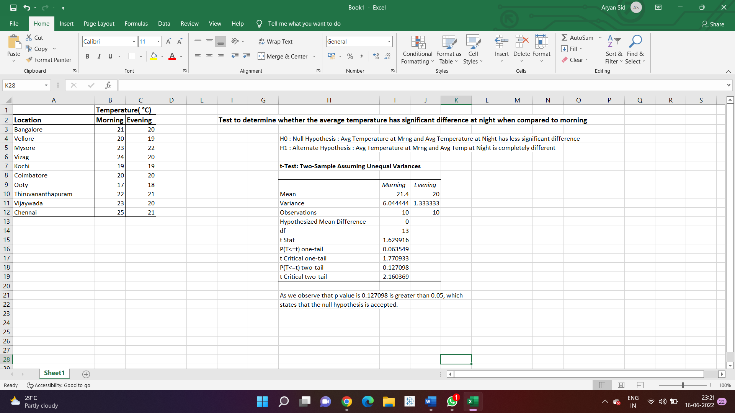
T-Test: Two Sample assuming unequal variances –
This tool executes a two-sample student's t-Test on data sets from two independent populations with unequal variances. This test can be either two-tailed or one-tailed contingent upon if we are testing that the two-population means are different or if one is greater than the other.

Slide 30
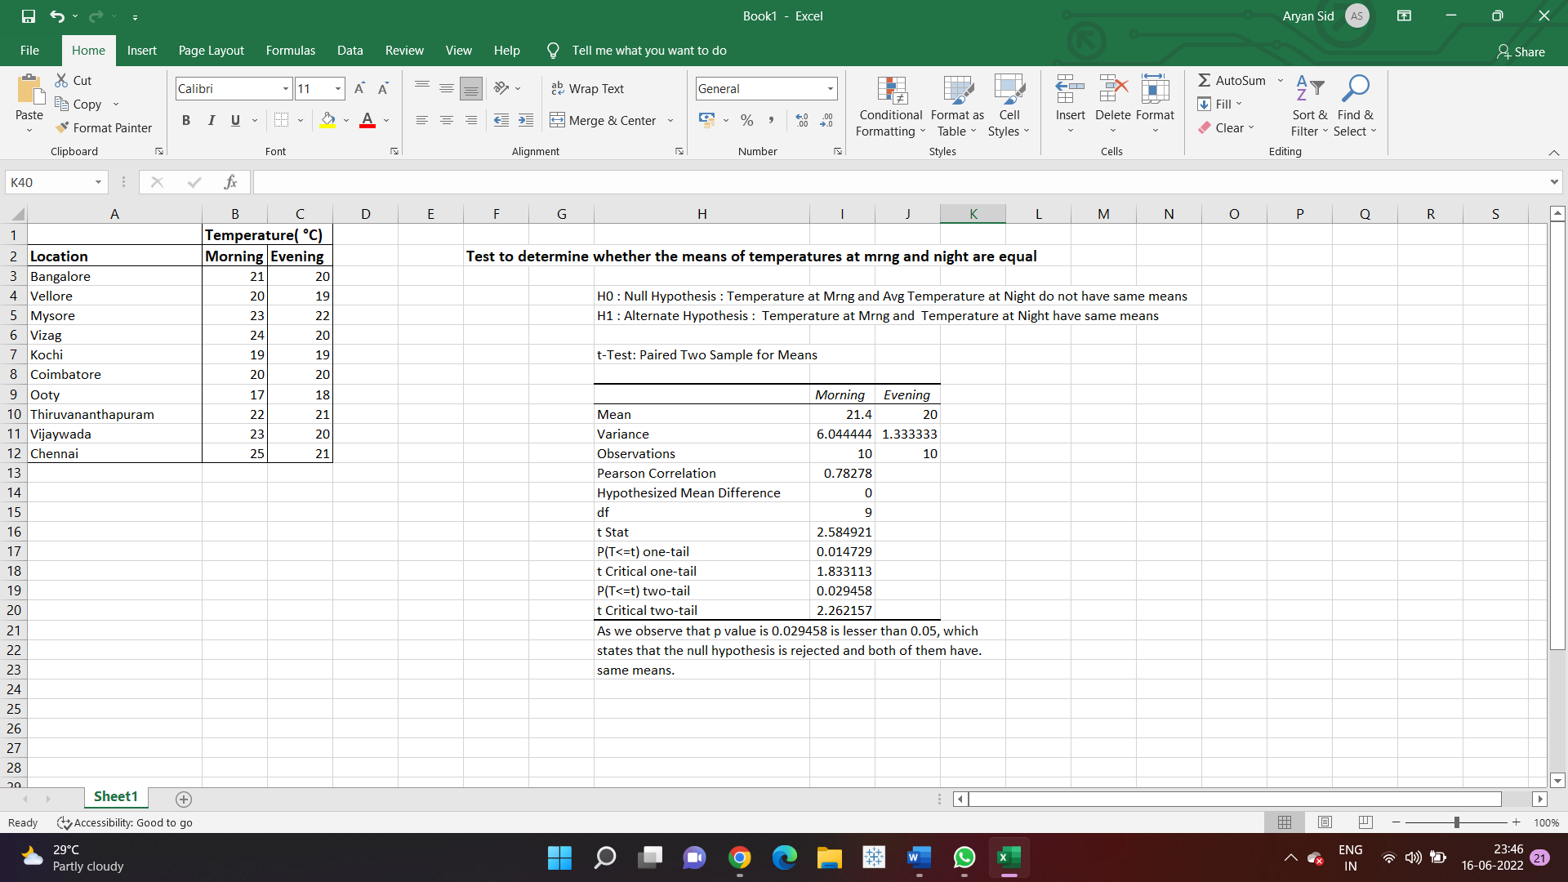
T-Test Paired Two Sample for Means -
The t-Test Paired Two Sample for Means tool performs a paired two-sample Student's t-Test to ascertain if the null hypothesis (means of two populations are equal) can be accepted or rejected. This test does not assume that the variances of both populations are equal.

Slide 31
Linear Programming Using Solver
Solver -
Solver is a Microsoft Excel add-in program you can use for what-if analysis. Use Solver to find an optimal (maximum or minimum) value for a formula in one cell — called the objective cell — subject to constraints, or limits, on the values of other formula cells on a worksheet.
The purpose of Solver Table is very much like that of an Excel data table: to vary one or two inputs and keep track of one or more outputs. The main difference is that Solver Table runs Solver for each input value (or combination of input values) and reports the optimal results in the table.
Linear Programming –
Linear programming is used for obtaining the most optimal solution for a problem with given constraints. In linear programming, we formulate our real-life problem into a mathematical model. It involves an objective function, linear inequalities with subject to constraints.

Slide 32
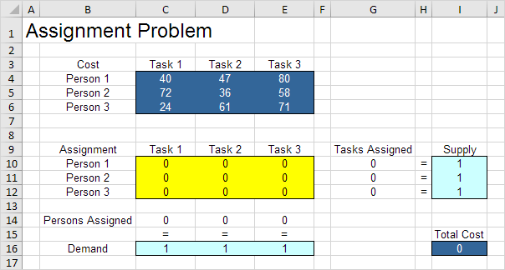
ASSIGNMENT PROBLEM –
The assignment problem is a fundamental combinatorial optimization problem. In its most general form, the problem is as follows: The problem instance has a number of agents and a number of tasks. Any agent can be assigned to perform any task, incurring some cost that may vary depending on the agent-task assignment.
For example –
An assignment problem is a particular case of transportation problem where the objective is to assign a number of resources to an equal number of activities so as to minimise total cost or maximize total profit of allocation.

Slide 33
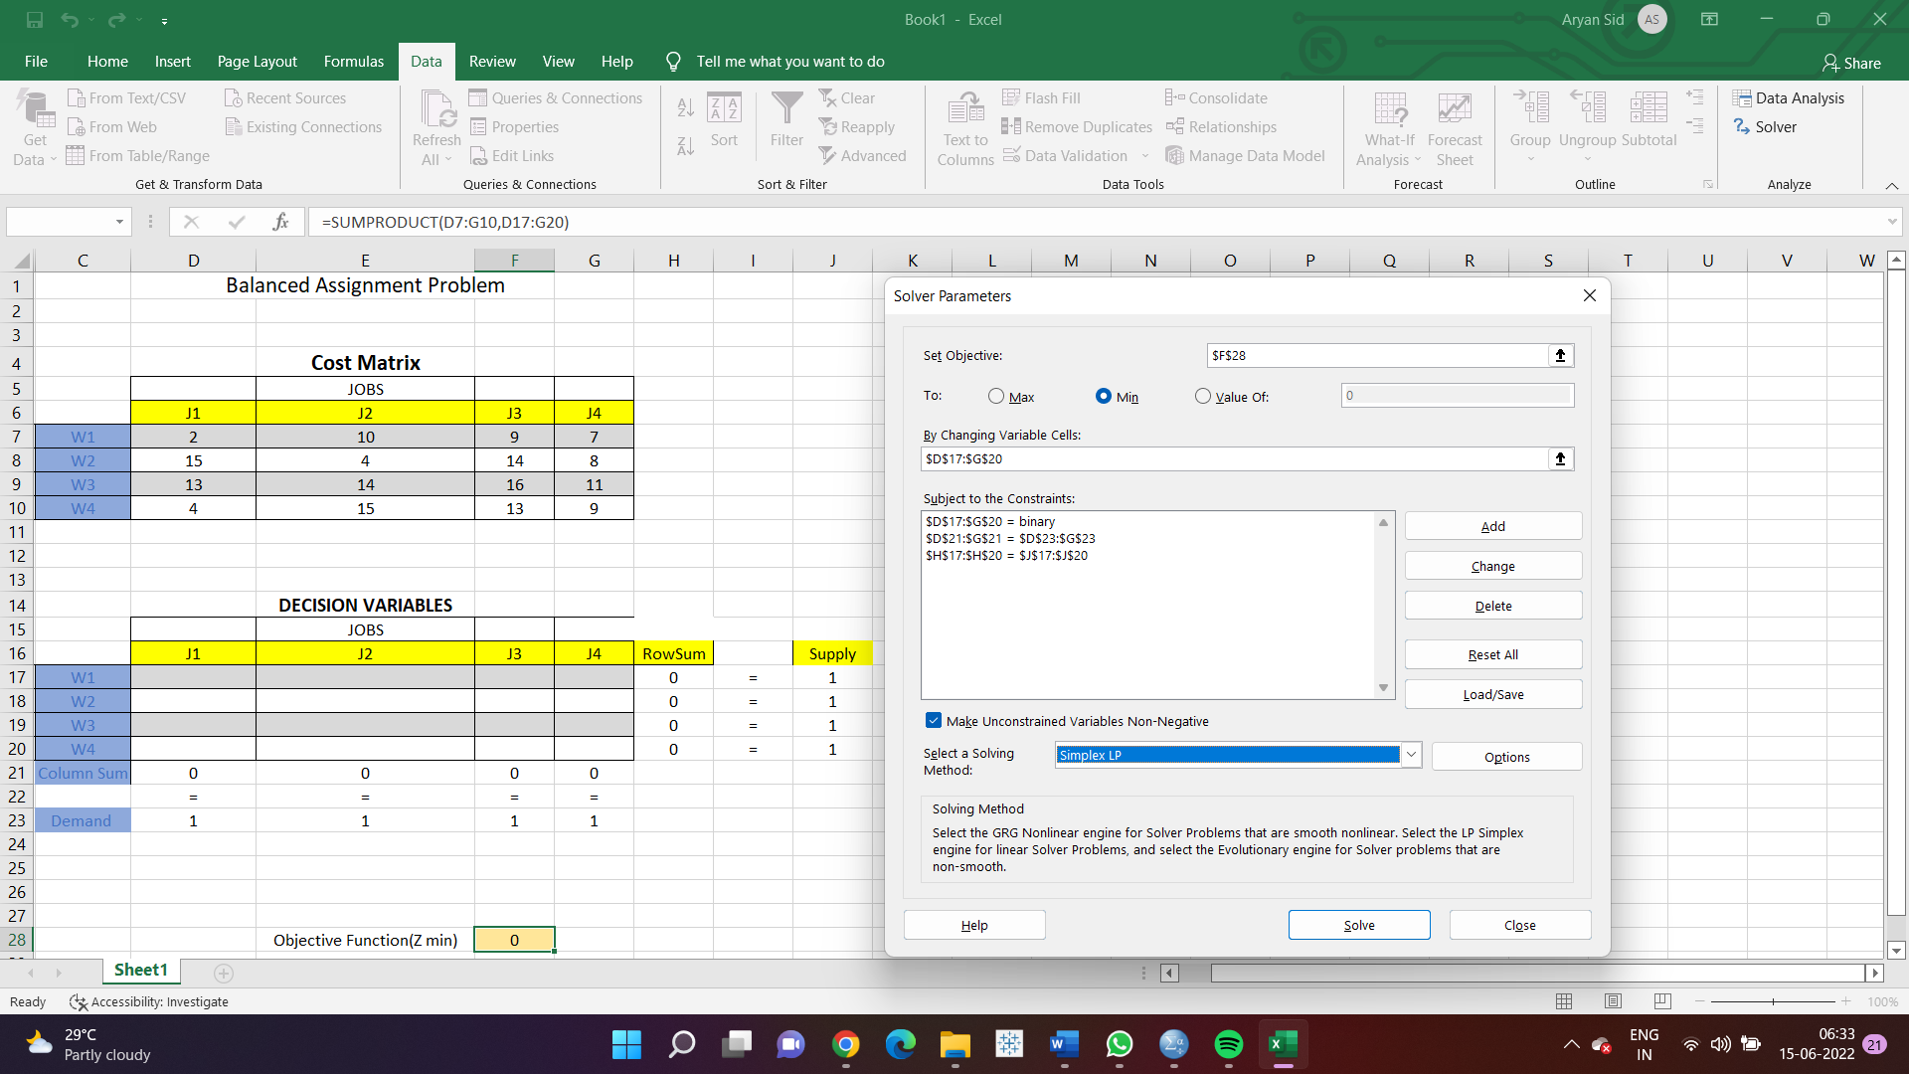
SOLVER OPTIONS AND DATA FOR THE ASSIGNMENT PROBLEM -

Slide 34
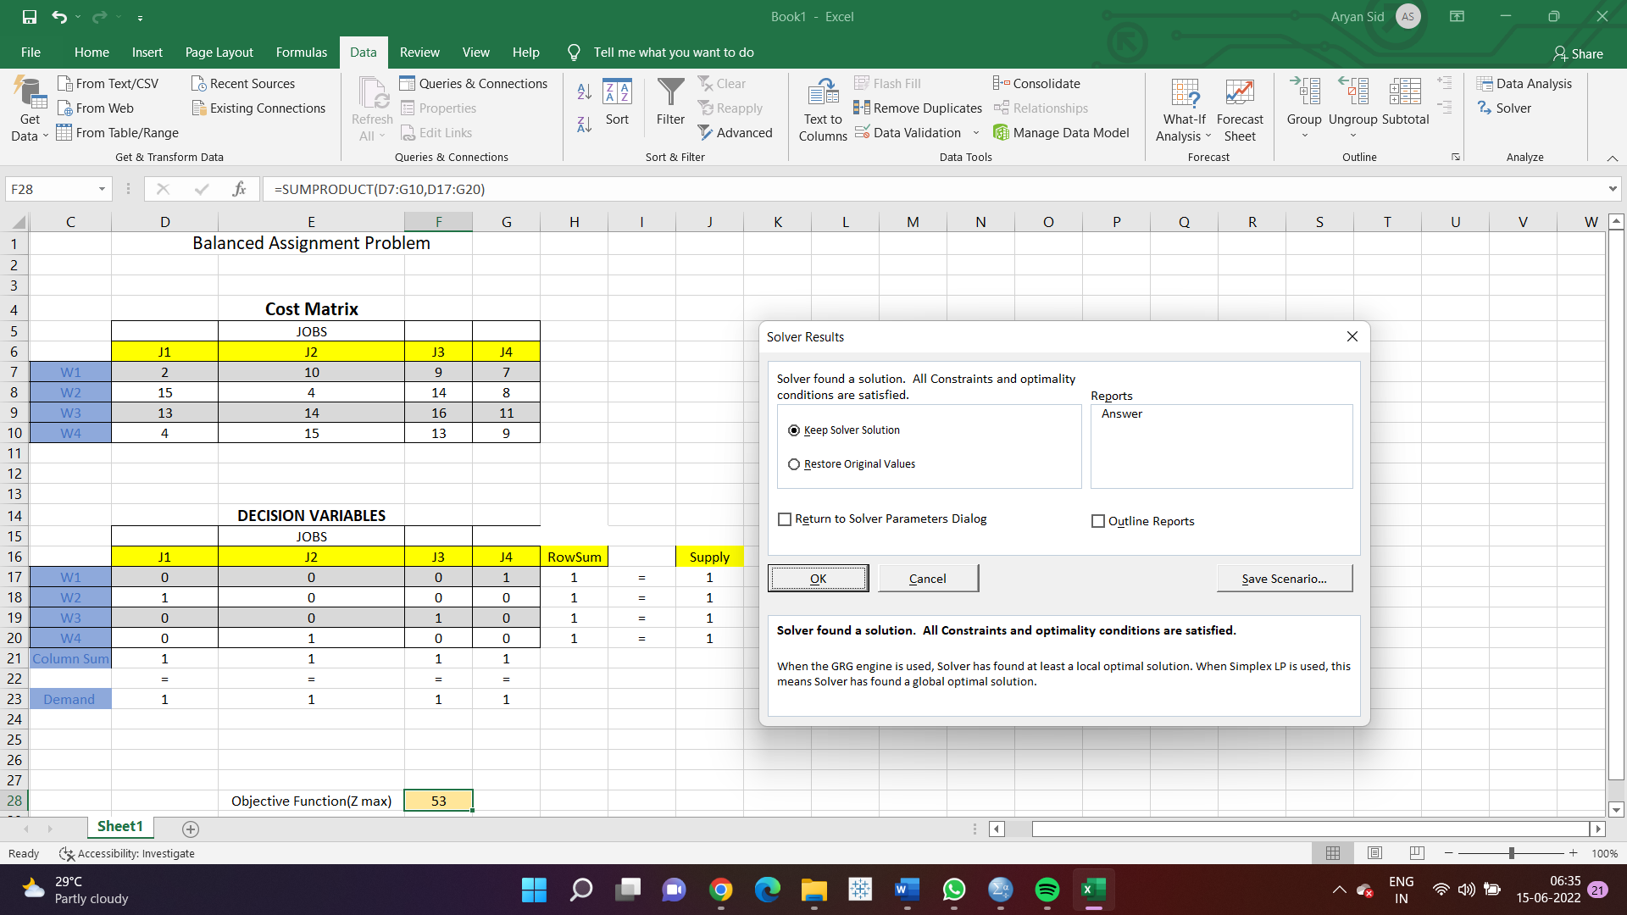
MAXIMIZING THE OUTPUT WHILE SATISFYING ALL THE CONSTRAINTS

Slide 35
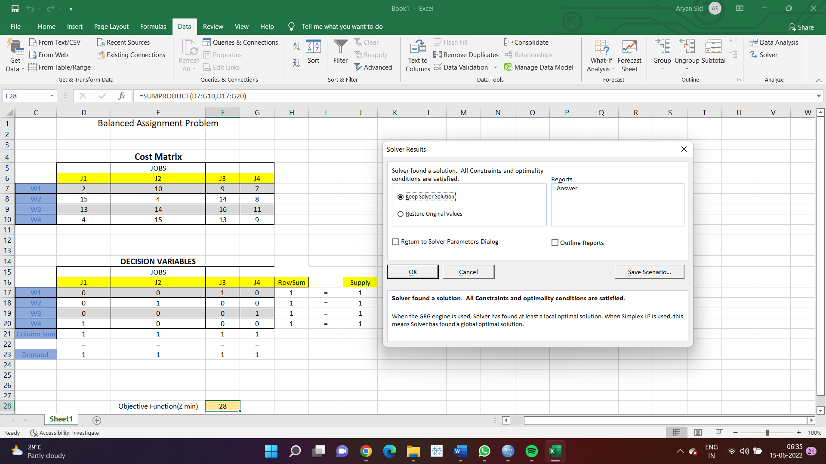
MINIMIZING THE OUTPUT WHILE SATISFYING ALL THE CONSTRAINTS

Slide 36

Tableau – Data Visualization Software
Tableau Software is an American Data Visualization software company focused on business intelligence. Tableau is a leading data visualization tool used for data analysis and business intelligence.
Excel works well when you have to create quick, one-off reports. Tableau is useful when you want a more detailed analysis of your business reports. Users can create and distribute an interactive and shareable dashboard, which depict the trends, variations, and density of the data in the form of graphs and charts. Tableau can connect to files, relational, and Big Data sources to acquire and process data. The software allows data blending and real-time collaboration, which makes it very unique.

Slide 37
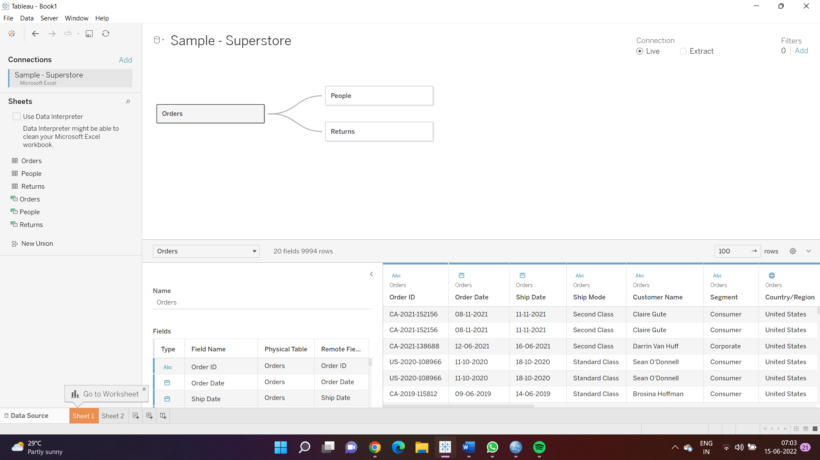
Data we will be working on –

Slide 38
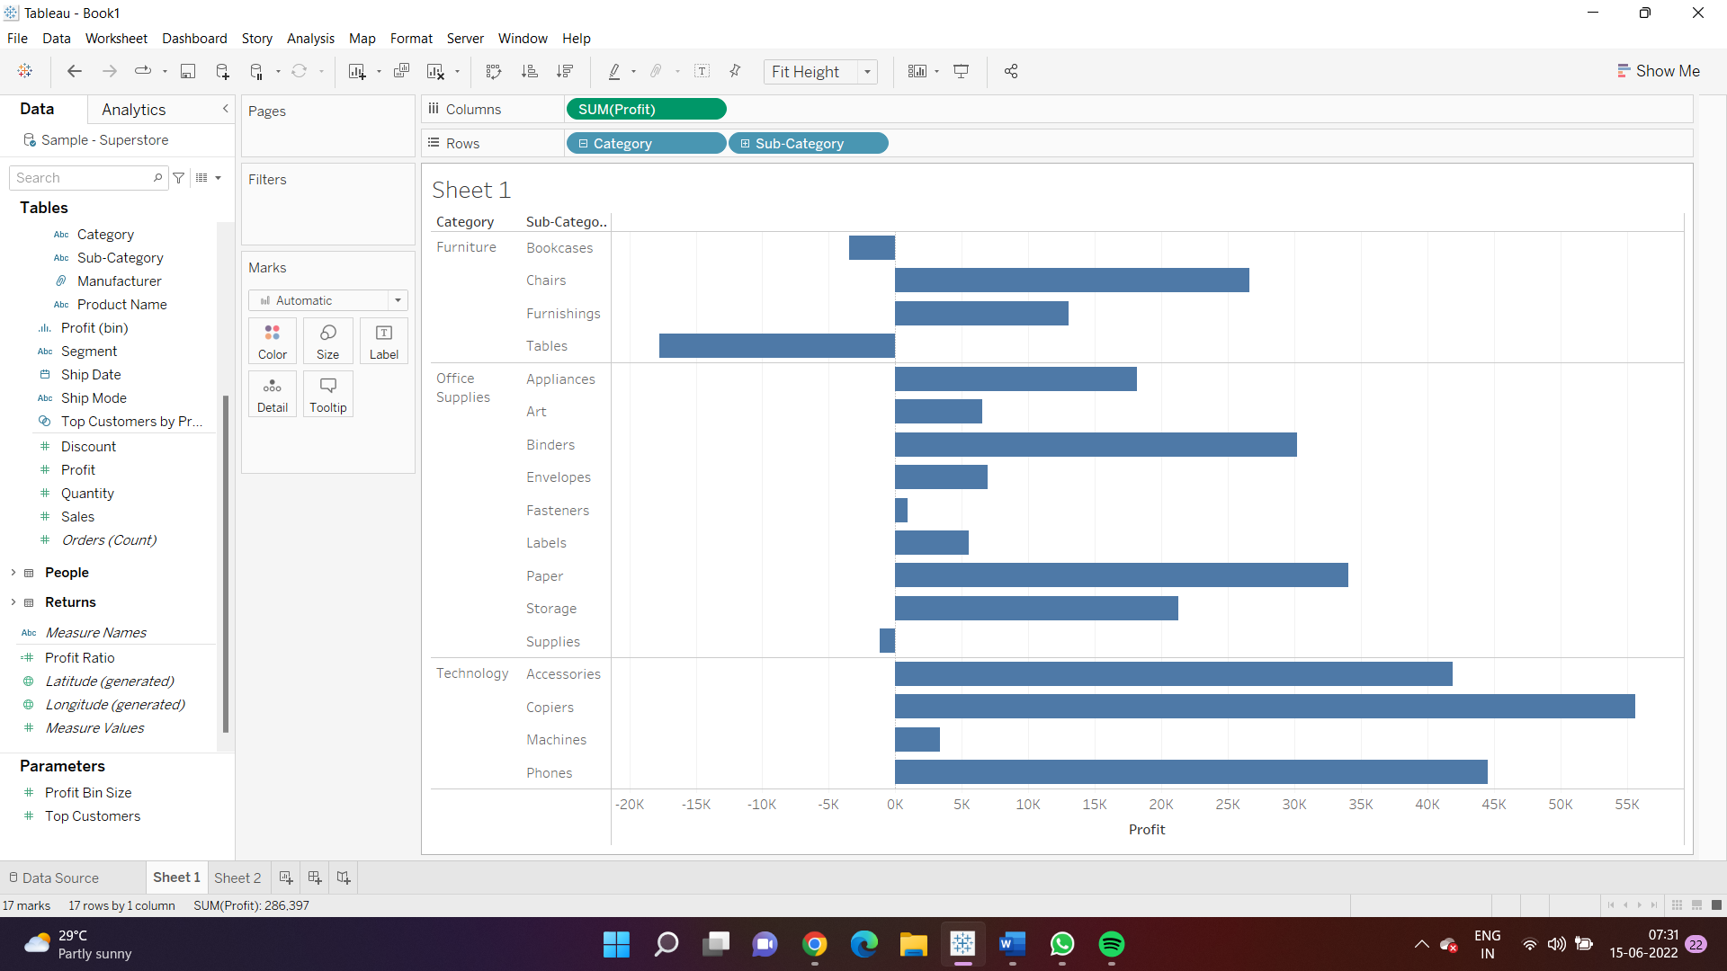
Creating Bar Graphs for Profit by Category -

Slide 39
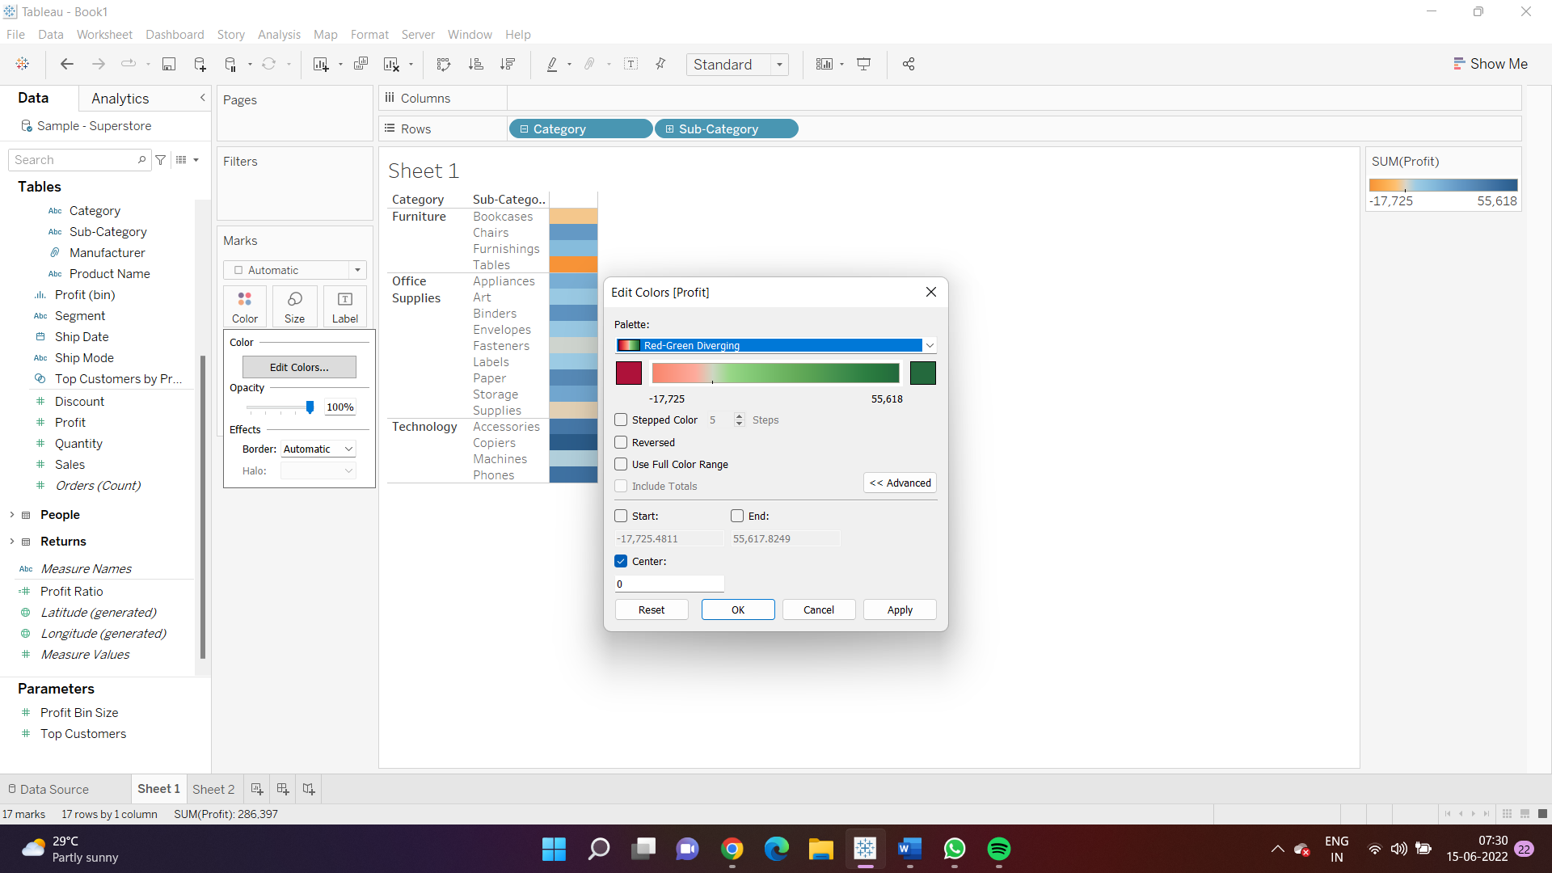
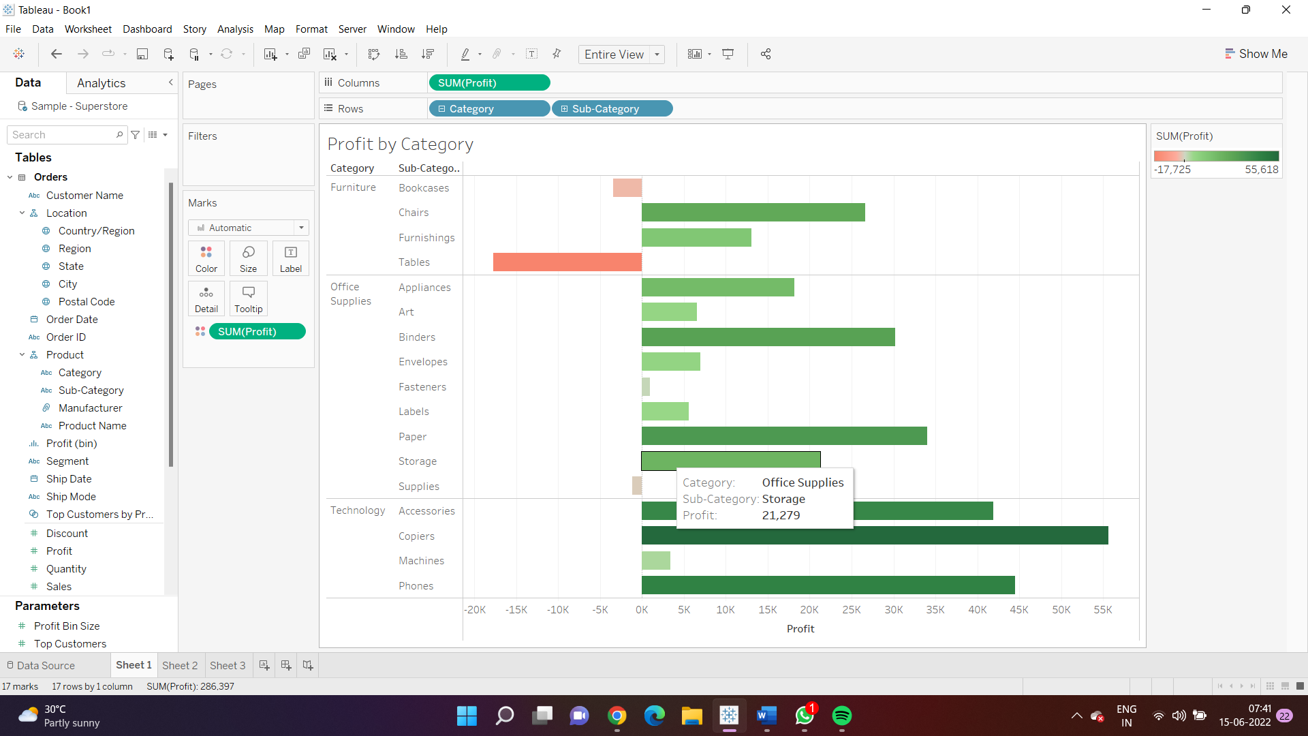
Establishing unique colors for easy identification of trends if there exists any or having a differentiations identification.

Slide 40
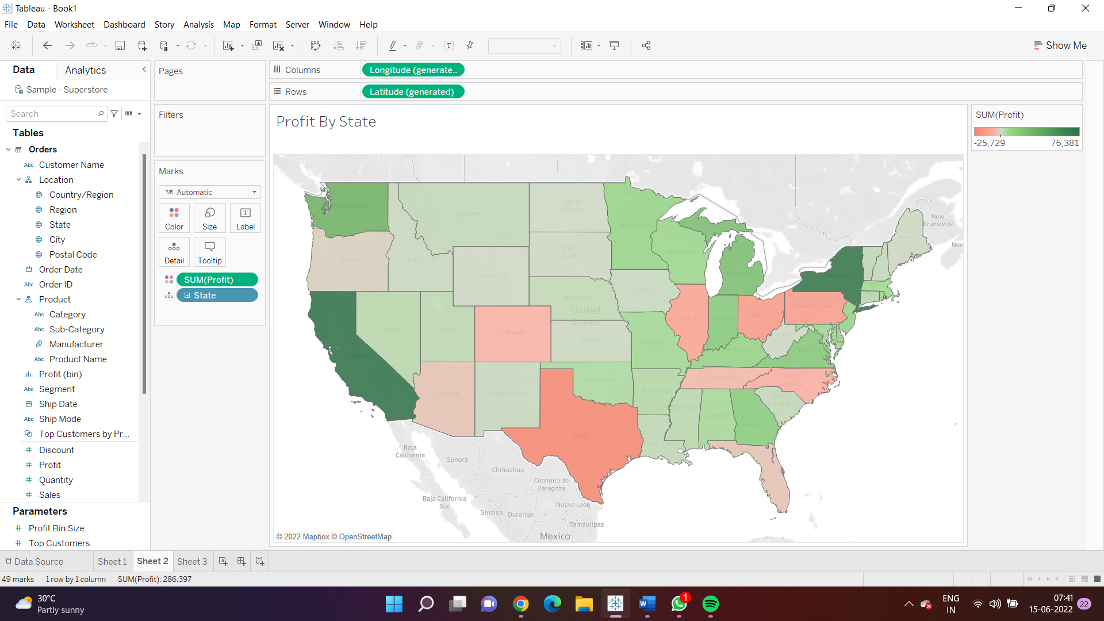
Profit By State -

Slide 41
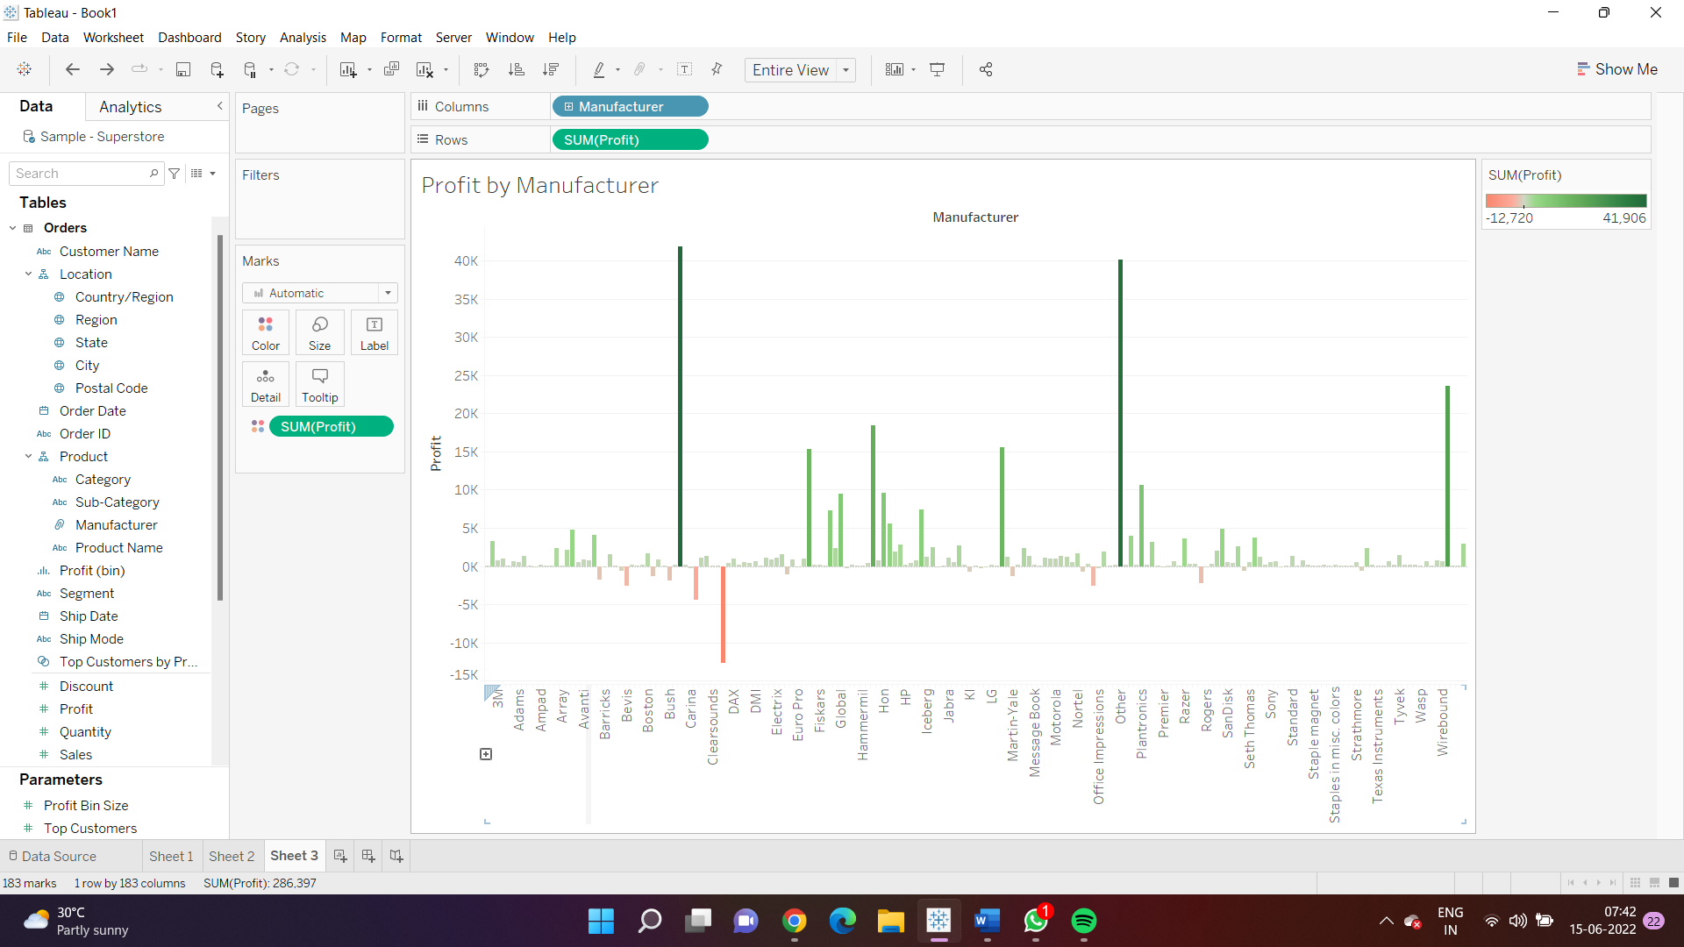
Profit By Manufacturer

Slide 42
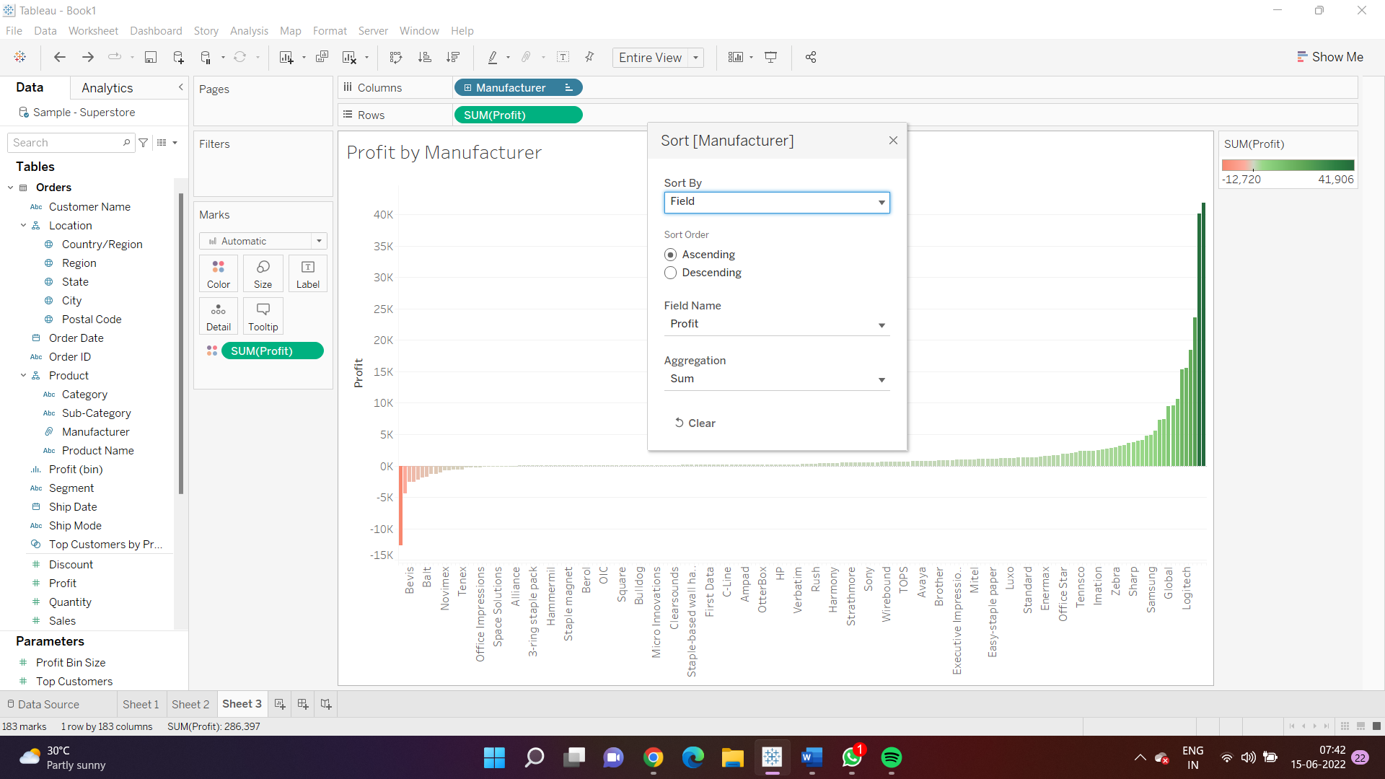
Sorting the above unsorted values in ascending order to identify positive trends in respective manufacturers and negative trends in respective manufacturers.

Slide 43
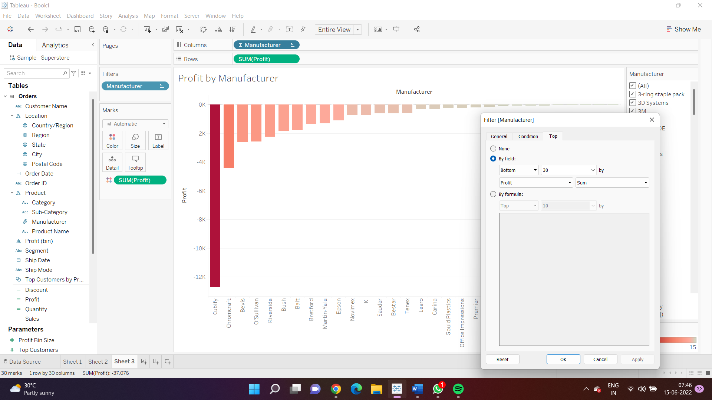
Displaying the bottom 30 profits by Manufacturer.

Slide 44
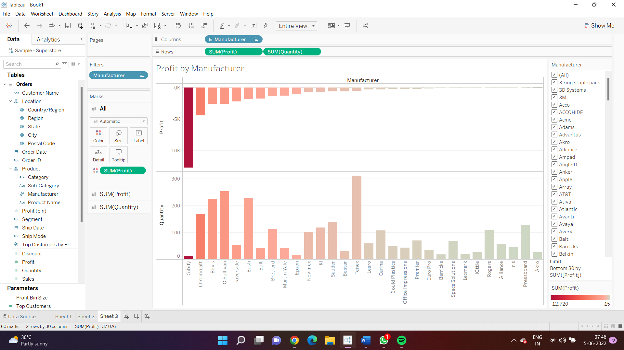
Analyzing The losses by the quantity sold, in order to identify the negative trends.

Slide 45
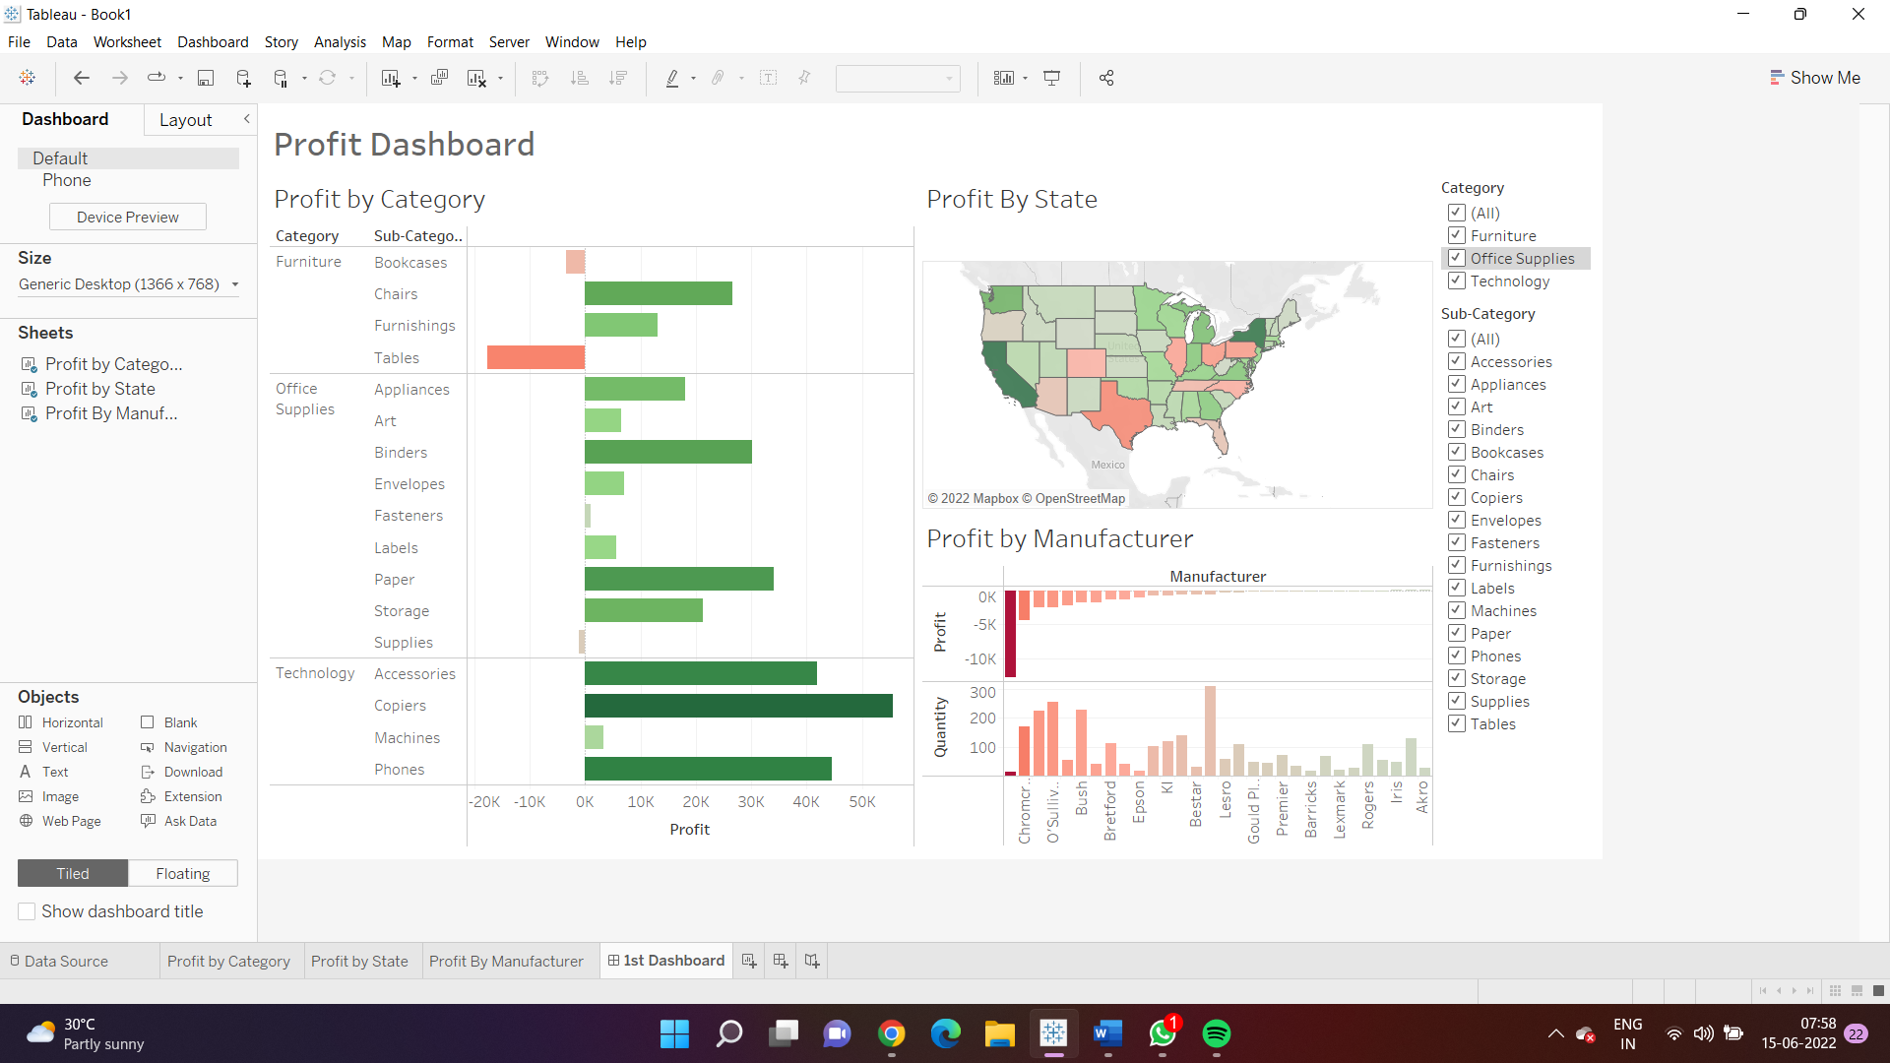
My Complete Tableau Dashboard based on the profits at different variables.

Slide 46
REFERENCES
For Definitions: https://www.google.co.in/
Linear Regression Analysis: https://www.ablebits.com/office-addins-blog/linear-regression-analysis-excel/
For SPSS and Tableau logo and images:
https://encryptedtbn0.gstatic.com/images?q=tbn:ANd9GcRavpMM7lvi8KVED8MYbTiiYdioYpiUzSvTRw&usqp=CAU
https://sybyl.com/wp-content/uploads/2019/11/Tableau-Logo-for-website.jpg
https://medium.com/@maithilijoshi6/a-comparison-between-linear-and-logistic-regression-8aea40867e2d

Slide 47


THANKYOU - TEAM INFERNO

